Slide 1
CODE OPTIMIZATION

Slide 2
Design Of a Compiler
Source code
Lexical Analysis
Syntax Analysis
Table Mgmt Routine
Error Handling Routine
Intermediate Code Generation
Code Optimization
Code Generation
Object code

Slide 3
What is optimization?
In computing, optimization is the process of modifying a system to make some aspect of it work more efficiently or use fewer resources. For instance, a computer program may be optimized so that it executes more rapidly, or is capable of operating with less memory storage or other resources, or draw less power. The system may be a single computer program, a collection of computers or even an entire network such as the internet.
υ

Slide 4
Levels' of optimization
Optimization can occur at a number of 'levels':
◆
Design level
At the highest level, the design may be optimized to make best use of the available resources. The implementation of this design will benefit from the use of suitable efficient algorithms and the implementation of these algorithms will benefit from writing good quality code. The architectural design of a system overwhelmingly affects its performance. The choice of algorithm affects efficiency more than any other item of the design.
Compile level
◆
Use of an optimizing compiler tends to ensure that the executable program is optimized at least as much as the compiler can predict.

Slide 5
Assembly level
υ
At the lowest level, writing code using an Assembly language designed for a particular hardware platform will normally produce the most efficient code since the programmer can take advantage of the full repertoire of machine instructions. The operating systems of most machines has been traditionally written in Assembler code for this reason.
υ
Runtime
Just In Time Compiler and assembler programmers are able to perform runtime optimization.

Slide 6
When to optimize ?
Optimization is often performed at the end of the development stage since it
reduces readability
adds code that is used to improve the performance.

Slide 7
Criteria For optimization
^{ü}An optimization must preserve the meaning of a program :
-Cannot change the output produced for any input
-Can not introduce an error
^{ü}optimization should, on average, speed up programs
^{ü}Transformation should be worth the effort

Slide 8
Improvements can be made at various phases:
Source Code
-Algorithms transformations can produce spectacular improvements
-Profiling can be helpful to focus a programmer’s attention on important code.
Intermediate Code:
-Compiler can improve loops, procedure calls and address calculations
-Typically only optimizing compilers include this phase
Target Code:
-Compilers can use registers efficiently
-Peephole transformation can be applied

Slide 9
Types of Code optimization
Common Sub-expression Removal
Dead Code Optimization
Loop Optimization

Slide 10
Common Sub expression elimination
Common Sub expression elimination is a optimization that searches for instances of identical expressions (i.e they all evaluate the same value), and analyses whether it is worthwhile replacing with a single variable holding the computed value.
temp=b * c a=temp + g d=temp * d
a=b * c + g
d=b * c * d

Slide 11
Dead code Optimization:
/
Dead Code elimination is a compiler optimization that removes code that does not affect a program. Removing such code has two benefits It shrinks program size, an important consideration in some contexts. It lets the running program avoid executing irrelevant operations, which reduces its running time.
Dead Code elimination is of two types
Unreachable Code
Redundant statement

Slide 12
Unreachable Code
In Computer Programming, Unreachable Code or dead code is code that exists in the source code of a program but can never be executed.
Program Code If (a>b)
m=a
elseif (a<b) m=b
elseif (a==b) m=0
else m=-1
Optimized Code
If (a>b) m=a
elseif (a<b) m=b
else m=0

Slide 13
Redundant Code
Redundant Code is code that is executed but has no effect on the output from a program
main(){
int a,b,c,r; a=5;
b=6;
c=a + b; r=2; r++;
printf(“%d”,c);
}
Adding time & space complexity

Slide 14
Loop optimization
Loop optimization plays an important role in improving the performance of the source code by reducing overheads associated with executing loops.
Loop Optimization can be done by removing:
Loop invariant
Induction variables

Slide 15
Loop Invariant
i = 1
s= 0 do{
s= s + i
i = 1
s= 0
a =5 do{
a =5
i = i + 1
s= s + i i = i + 1
{
while (i < =n)
{
while (i < =n)
Bringing a=5 outside the do while loop, is called code motion.

Slide 16
Induction variables
i = 1 s= 0 S1=0 S2=0 | i = 1 s= 0 S1=0 S2=0
while (i < =n) | t2=0
{ | while (i < =n)
s= s + a[ i ] t1 = i * 4 | { s= s + a[ i ] | “+” replaced “ * ”,
s= s + b[ t1 ] | t1 = t1+ 4 | t1 was made
t2 = t1 +2 | s= s + b[ t1 ] | independent of i
s2= s2 + c[ t2 ] | s2= s2 + c[t1 +2 ]
i = i + 1 | i = i + 1
} | }
t1,t2 are induction variables. i is inducing t1 and t1 is inducing t2

Slide 17
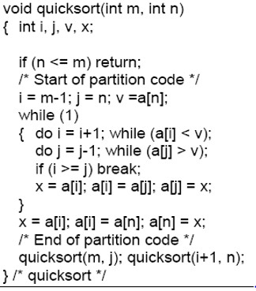
Quick Sort in C

Slide 18
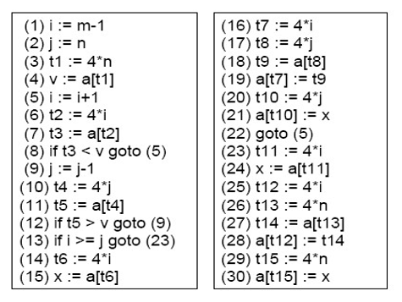
Three-Address Code of Quick sort in C

Slide 19
Control Flow Graph
Nodes represent basic blocks
The initial node is the block whose leader is the first statement
There exits an edge from B_{i} to B_{j} if:
There is a conditional or unconditional jump from the last statement in B_{i} to the statement in B_{j}
B_{j} immediately follows B_{i} in the order of the program, and B_{i} does not end in an unconditional jump

Slide 20
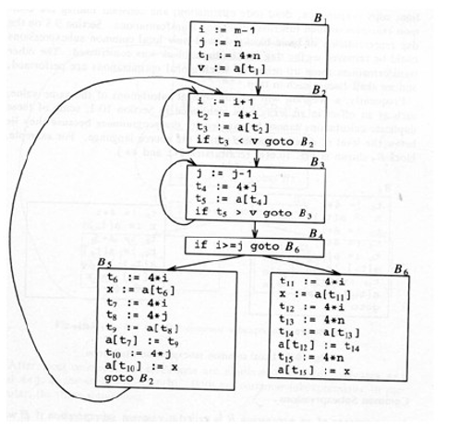
Flow Graph of Quick Sort

Slide 21
Common Sub-expression Removal
It is used to remove redundant computations which usually improves the execution time of a program.
E is a common subexpression if:
E was previously computed
Variables in E have not changed since previous computation
Can avoid recomputing E if previously computed value is still available
Dags are useful to detect common subexpression

Slide 22
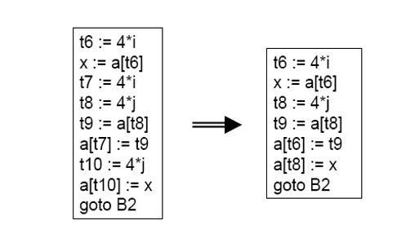
Local Common Sub expressions

Slide 23
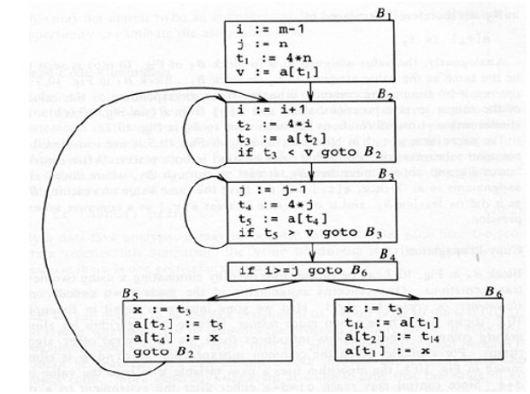
Global Common Sub expressions

Slide 24
Copy Propagation
Assignment of the form F:=g are called copy statements
The idea behind copy propagation is to use g for f whenever possible after such a statement
For example, applied to block B5 of the previous flow graph, we obtain:
X:= t3
a[t2] := t5
a[t4] :=t3
goto B2
Copy propagation often turns the copy statement into “dead code”

Slide 25
Loop Optimizations
The running time of a program may be improved if we do both of the following:
Decrease the number of statements in a inner loop
Increase the number of statements in a outer loop
Code motion moves code outside of a loop
for example, consider:
while(i<=limit-2)
The result of code motion would be:
t = limit -2
while(i<=t)

Slide 26
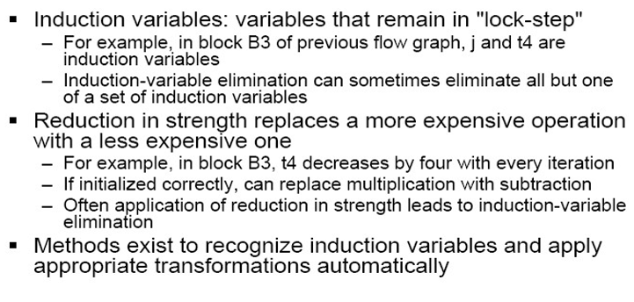
CONTINUE

Slide 27
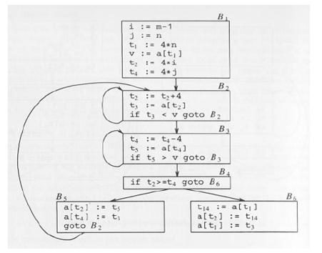
Loop Optimization Example

